Slide 1
Energy-Efficient Neuromorphic Computing
MS Project: Midterm Presentation
Khritish Kumar Behera
Roll: 17125, Email: khritish17@iiserb.ac.in
Electrical Engineering and Computer Science [EECS] Dept.
Indian Institute of Science Education and Research [IISER] Bhopal
Advisor: Dr. Kuntal Roy, Email: kuntal@iiserb.ac.in
Team:
M Mohanlal Naik, PhD Student,
Priyesh Kumar, PhD Student

Slide 2

Energy-Efficient Neuromorphic Devices
Spintronic devices have some inherent advantages
Encapsulation of weights, sum, and threshold functions
Non-Boolean computing
Neuron
Neural network
x₁
w₁
w₂
y = f(u)
x₂
$$Σ$$
.
.
.
w_{n}
f
x_{n}
y
Piezoelectric
x₁
x₂
x_{n}
.
.
ReadMTJ
Neuromorphic devices
using multiferroics
Insulator
Magnetostrictive
Write

Slide 3
Energy-Efficient Neuromorphic Computing
Artificial Neural Network:
Google Home, Alexa, Google Assistant, Siri, Tesla Cars
Brain Inspired Computing on hardware:
Hardware devices
Transistor vs Spin-electronics
Inherent advantages of using spin-electronics: (1) Energy Efficient (2) High data retention time (3) No extra circuitry for activation function
Compare the energy dissipation between transistor based neurons and spin based neurons
Khritish Kumar Behera

Slide 4
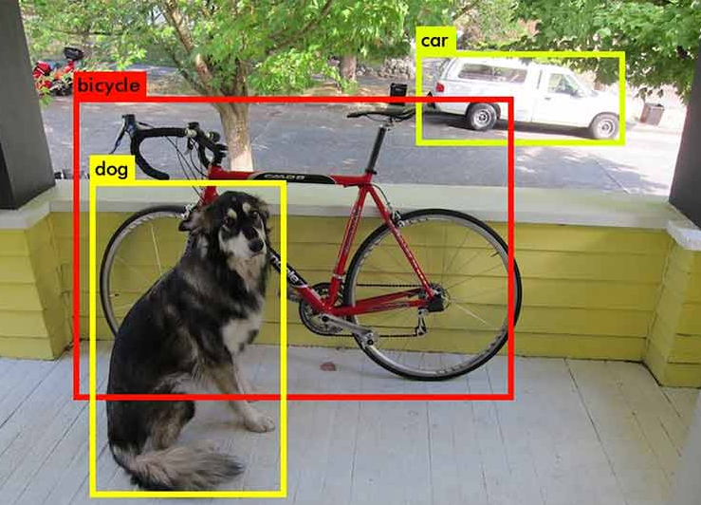

Artificial Neural Network: Motivation
Object Detection and Object Identification [1]
Face Recognition [3]
Sources:
https://miro.medium.com/max/1400/1*IrptRDRG8IL9o-55BKjbLA.png
https://hackster.imgix.net/uploads/attachments/1073216/dl_medical_imaging_malaria_dataset_8DrQhbFeEr.jpg
https://miro.medium.com/max/875/1*x4nz_cq2ZX0pBrPjB6PLZg.jpeg
Khritish Kumar Behera

Slide 5
Artificial Neural Network
Neural Network is a two-phase process
Training of a model is required, to use the model to find the output with accuracy for unknown data at later stage
Training Phase
Testing Phase
Training Phase:
Makes the model learn/train the data it will be working on
Uses training data to train the model
ERROR: T - O
Training Data: (X , T)
X: Input to the model
T: Target expected out of the model
X
O
Khritish Kumar Behera

Slide 6
Artificial Neural Network: Testing Phase
Neural Network is a two-phase process
Training Phase
Testing Phase
Testing Phase:
Once the model is fully trained, it can be used to predict the output of unknown data with same underlying features
Testing Data: (X , ?)
X: Input to the model
X
O
Khritish Kumar Behera

Slide 7
Artificial Neural Network: Example
A
.
.
.
Khritish Kumar Behera

Slide 8
Artificial Neural Network: Perceptron
X1
W1
b
X2
W2
∑
σ
Y
X3
W3
Khritish Kumar Behera

Slide 9
Artificial Neural Network: Perceptron
X1
W1
b
X2
W2
∑
σ
Y
X3
W3
A Simple Perceptron can have more than one input, but the output needs to be just one
Each input edge has a weight associated with it, which can be negative / positive / zero
Each node has a ‘bias’ term associated with it
The Neuron Process through two sequential processes: Summation and Activation
Khritish Kumar Behera

Slide 10
Artificial Neural Network: Perceptron
W1
Calculates the weighted inputs
Summation of Weighted inputs
Adds the bias term
Applies the activation function
X1
b
X2
W2
∑
σ
Y
X3
W3
Khritish Kumar Behera

Slide 11
Artificial Neural Network: Perceptron
W1
Calculates the weighted inputs
Summation of Weighted inputs
Adds the bias term
Applies the activation function
X1
b
X2
W2
∑
σ
Y
X3
W3
X1.W1 X2.W2 X3.W3
Khritish Kumar Behera

Slide 12
Artificial Neural Network: Perceptron
W1
Calculates the weighted inputs
Summation of Weighted inputs
Adds the bias term
Applies the activation function
X1
b
X2
W2
∑
σ
Y
X3
W3
( X1.W1 + X2.W2 + X3.W3 )
Khritish Kumar Behera

Slide 13
Artificial Neural Network: Perceptron
W1
Calculates the weighted inputs
Summation of Weighted inputs
Adds the bias term
Applies the activation function
X1
b
X2
W2
∑
σ
Y
X3
W3
( X1.W1 + X2.W2 + X3.W3 + b)
Khritish Kumar Behera

Slide 14
Artificial Neural Network: Perceptron
W1
Calculates the weighted inputs
Summation of Weighted inputs
Adds the bias term
Applies the activation function
X1
b
X2
W2
∑
σ
Y
X3
W3
σ( X1.W1 + X2.W2 + X3.W3 + b)
Khritish Kumar Behera

Slide 15
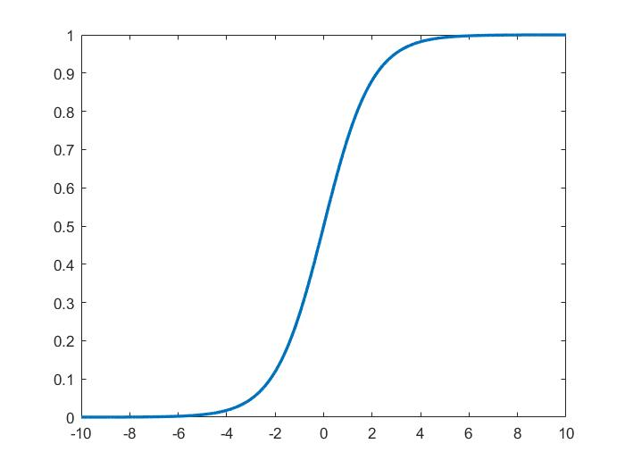
Artificial Neural Network: Activation Function
Activation Function is a non-linear mathematical function
Inspired from our biological Neuron
Non-linearity is the key to success for an ANN
X1
W1
b
X2
W2
∑
σ
Y
X3
W3
Khritish Kumar Behera

Slide 16
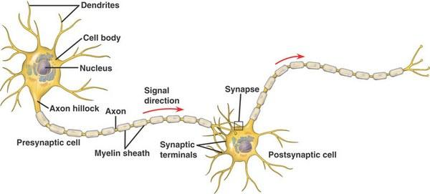
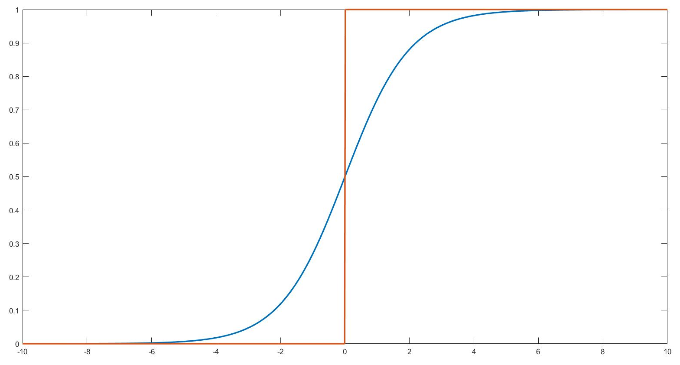
Artificial Neural Network: Activation Function
Source:
https://www.poznavayka.org/en/science-and-technology/neural-networks/
Activation Function is a non-linear mathematical function
Inspired from our biological Neuron
Non-linearity is the key to success for an ANN
Khritish Kumar Behera

Slide 17
Artificial Neural Network: Activation Function
Activation Function is a non-linear mathematical function
Inspired from our biological Neuron
Non-linearity is the key to success
The Yellow circle and the red square are linearly classifiable
The Yellow circle and the red square are not linearly classifiable
Khritish Kumar Behera

Slide 18
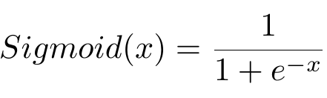
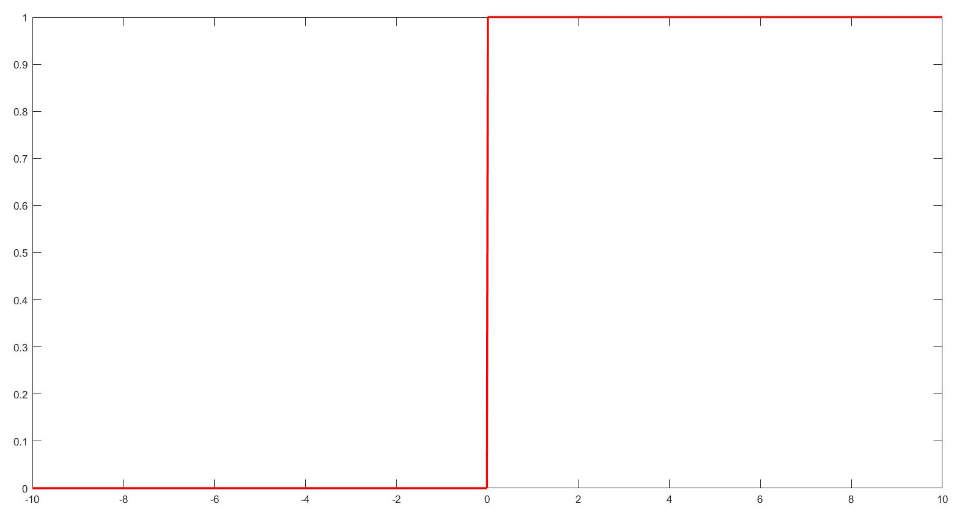
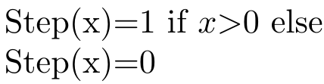
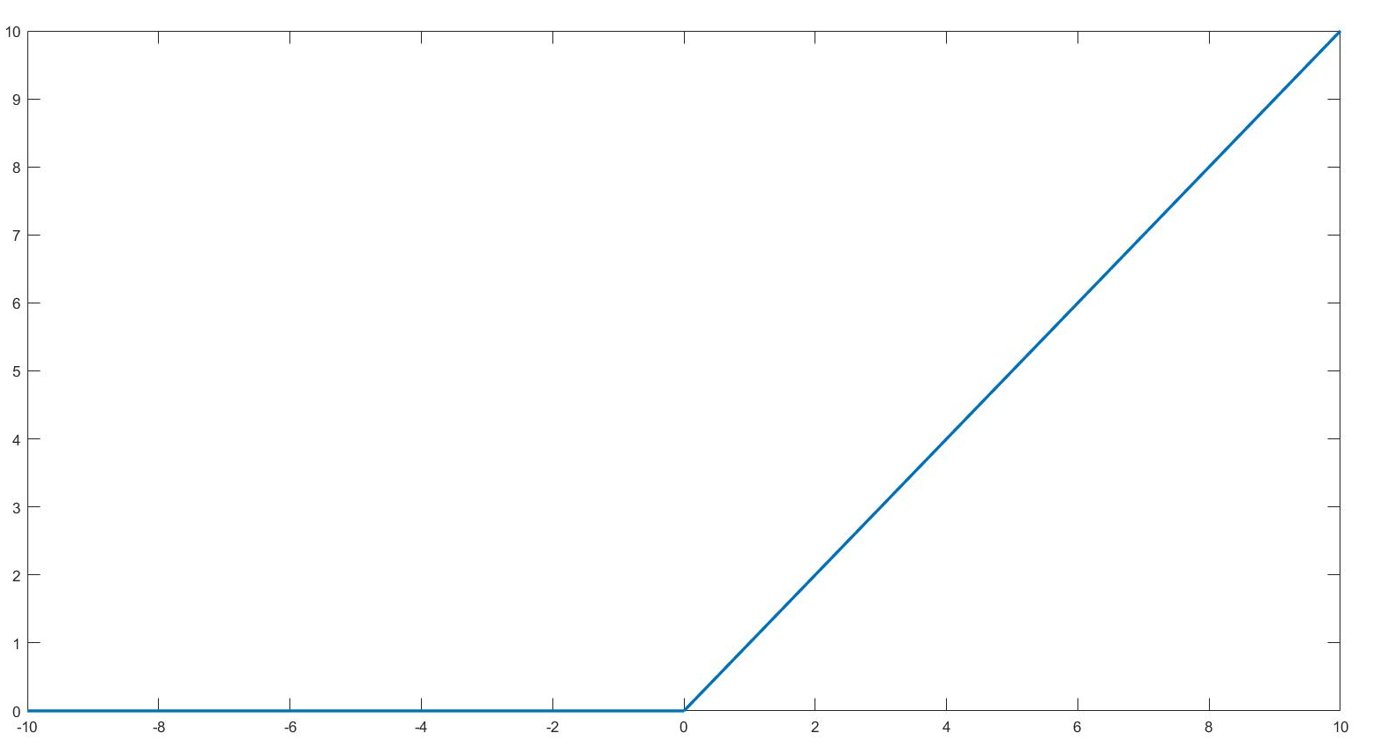
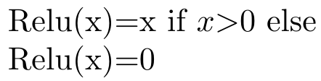
Artificial Neural Network: Activation Function
Step Function
Sigmoid Function
Rectilinear Unit Function
Khritish Kumar Behera

Slide 19
Artificial Neural Network: Simple ANN
2
4
1
5
3
Khritish Kumar Behera

Slide 20
Artificial Neural Network: Simple ANN
2
4
An Artificial Neural Network is a system of connected artificial neurons
1
Generally divided in many layers
5
3
Output of each neuron of one layer is connected to the all of the neurons in the next layer
There are no self loops, no feedback loops
More than one edge emerging out of a neuron, does not mean that there are multiple output of the neuron
Khritish Kumar Behera

Slide 21
Artificial Neural Network: Simple ANN
2
4
An Artificial Neural Network is a system of connected artificial neurons
1
Generally divided in many layers
5
3
INPUT LAYER:
Neurons in the input layer is the original input feed into the system
There has to be at least one input neuron in the Input Layer
Neurons in the Input Layer does not alter the input in any sense.
Khritish Kumar Behera

Slide 22
Artificial Neural Network: Simple ANN
2
4
An Artificial Neural Network is a system of connected artificial neurons
1
Generally divided in many layers
5
3
HIDDEN LAYER:
Neurons in the hidden layer alters the input it gets
There has to at least one hidden layer
There has to be at least one hidden neuron in each hidden layer
Khritish Kumar Behera

Slide 23
Artificial Neural Network: Simple ANN
2
4
An Artificial Neural Network is a system of connected artificial neurons
1
Generally divided in many layers
5
3
OUTPUT LAYER:
Number of the neurons in the output layer depends on the problem
It is the layer which finally gives output to the end user
Khritish Kumar Behera

Slide 24
Artificial Neural Network: Forward Propagation
b2
b3
W1
W2
1
2
3
X
Y
Khritish Kumar Behera

Slide 25

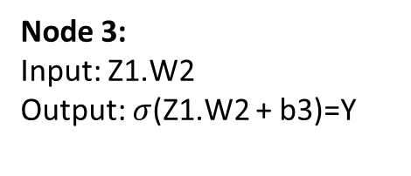
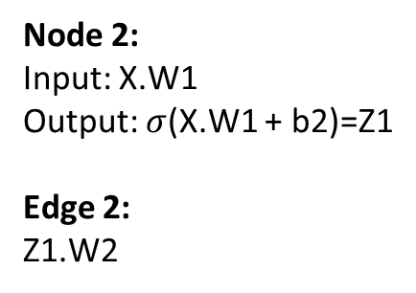
Artificial Neural Network: Forward Propagation
X → X.W1 → X.W1+b2 → $σ$(X.W1+b2) → Z1.W2 → Z1.W2+b3 → $σ$(Z1.W2+b3)
b2
b3
W1
W2
1
2
3
X
Y
Node 1:
Input: X
Output: X
Edge 1:
X.W1
Node 2:
Input: X.W1
Output: $σ$(X.W1 + b2)=Z1
Edge 2:
Z1.W2
Node 3:
Input: Z1.W2
Output: $σ$(Z1.W2 + b3)=Y
$$Y=σ( σ\left(X.W1+b2\right)W2+b3)$$
Khritish Kumar Behera

Slide 26
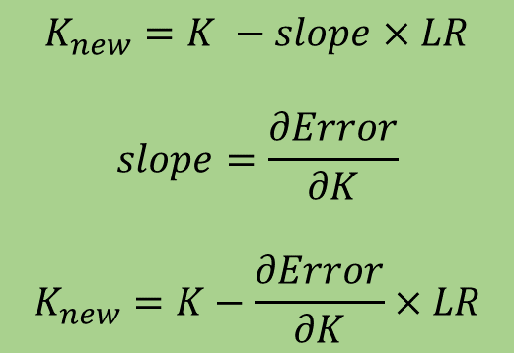
Artificial Neural Network: Gradient Descent
Error
Initial Point
$$K_{new}=K −slope×LR$$
$$slope=\frac{∂Error}{∂K}$$
$$K_{new}=K−\frac{∂Error}{∂K}×LR$$
K (Optimizing Parameter)
LR : Learning Rate
Khritish Kumar Behera

Slide 27
Artificial Neural Network: Gradient Descent
Error
K (Optimizing Parameter)
Khritish Kumar Behera

Slide 28
Artificial Neural Network: Backpropagation
Target
b2
b3
T
W1
W2
1
2
3
X
Y
Khritish Kumar Behera

Slide 29
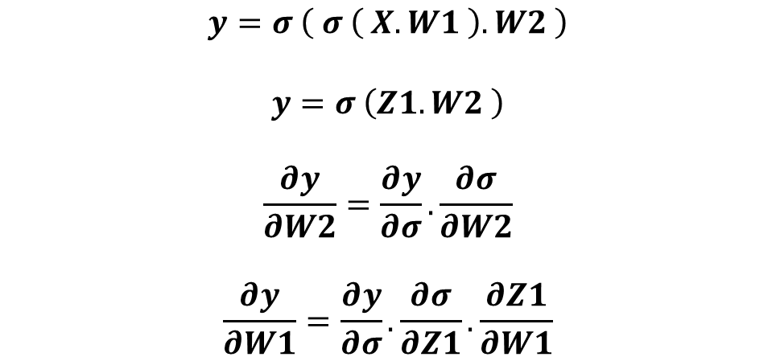
Artificial Neural Network: Backpropagation
W1
W2
1
2
3
X
Y
T
$$y=σ \left( σ \left( X.W1 \right).W2 \right)$$
$$y=σ \left(Z1.W2 \right)$$
$$\frac{∂y}{∂W2}=\frac{∂y}{∂σ}.\frac{∂σ}{∂W2}$$
$$\frac{∂y}{∂W1}=\frac{∂y}{∂σ}.\frac{∂σ}{∂Z1}.\frac{∂Z1}{∂W1}$$
Target
Khritish Kumar Behera

Slide 30
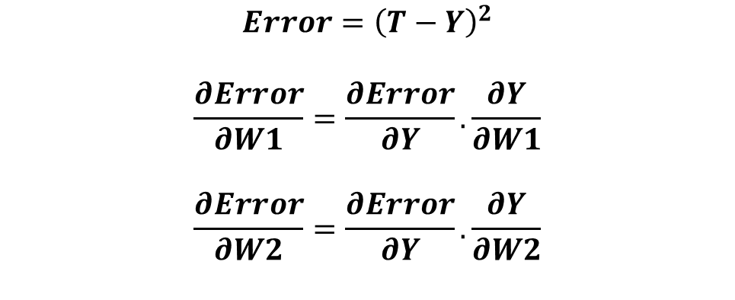
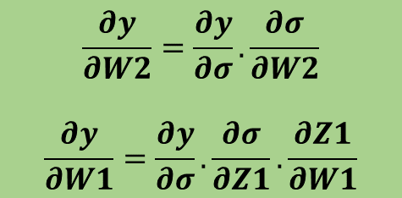
Artificial Neural Network: Backpropagation
W1
W2
1
2
3
X
Y
T
$$\frac{∂y}{∂W2}=\frac{∂y}{∂σ}.\frac{∂σ}{∂W2}$$
$$\frac{∂y}{∂W1}=\frac{∂y}{∂σ}.\frac{∂σ}{∂Z1}.\frac{∂Z1}{∂W1}$$
$$Error={\left(T−Y\right)}^{2}$$
$$\frac{∂Error}{∂W1}=\frac{∂Error}{∂Y}.\frac{∂Y}{∂W1}$$
$$\frac{∂Error}{∂W2}=\frac{∂Error}{∂Y}.\frac{∂Y}{∂W2}$$
Target
Khritish Kumar Behera

Slide 31




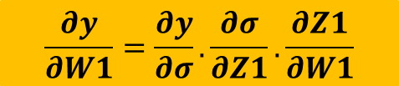

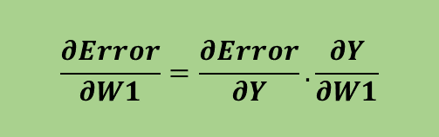




Artificial Neural Network: Backpropagation
W1
W2
1
2
3
X
Y
T
$$X$$
$$Z1$$
$$Y$$
Target
1
$$Error$$
$$W1$$
$$σ$$
$$W2$$
$$σ$$
$$\frac{∂Error}{∂W1}=\frac{∂Error}{∂Y}.\frac{∂Y}{∂W1}$$
$$\frac{∂y}{∂W1}=\frac{∂y}{∂σ}.\frac{∂σ}{∂Z1}.\frac{∂Z1}{∂W1}$$
$$W1_{new}=W1 − \frac{∂Error}{∂W1}×LR$$
Khritish Kumar Behera

Slide 32
Artificial Neural Network: Character Recognition
We wish to create an ANN which can recognize alphabets from a noisy 7x5 pixel binary pattern
A
A
Khritish Kumar Behera

Slide 33
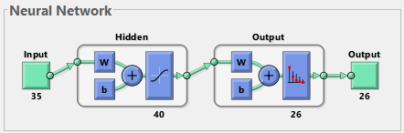
Artificial Neural Network: Character Recognition
Input:
35 Pixel values of the test character
Output:
26 bit array suggesting the character
A: 1,0,0,0,0,0,0,0,…..0,0,0,0
B: 0,1,0,0,0,0,0,0,……0,0,0,0
C: 0,0,1,0,0,0,0,0,……0,0,0,0
Similarly others
Khritish Kumar Behera

Slide 34
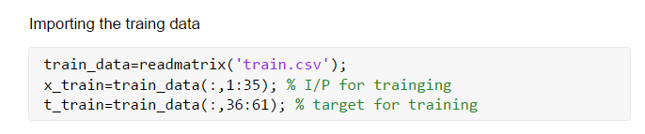
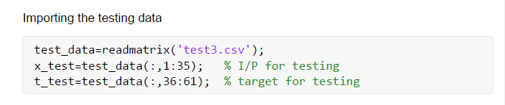
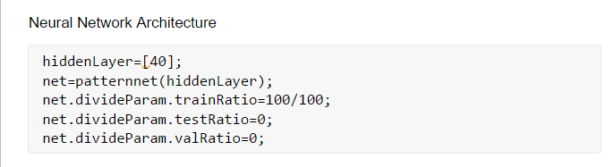
Artificial Neural Network: Character Recognition
Khritish Kumar Behera

Slide 35
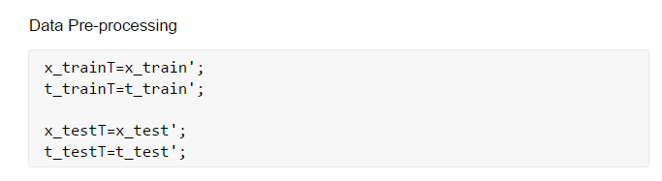
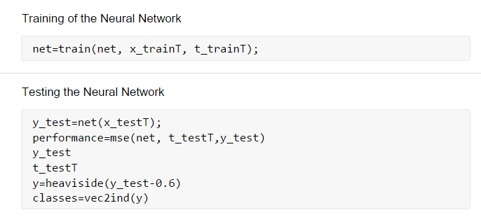
Artificial Neural Network: Character Recognition
Khritish Kumar Behera

Slide 36
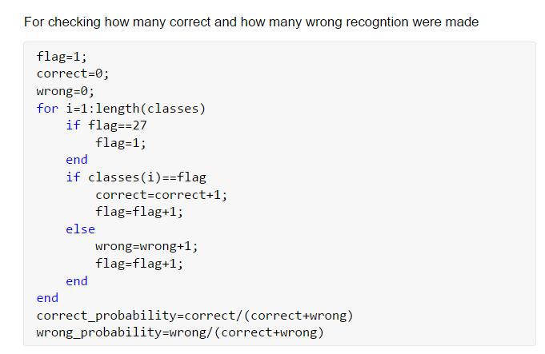

Artificial Neural Network: Character Recognition
Khritish Kumar Behera

Slide 37
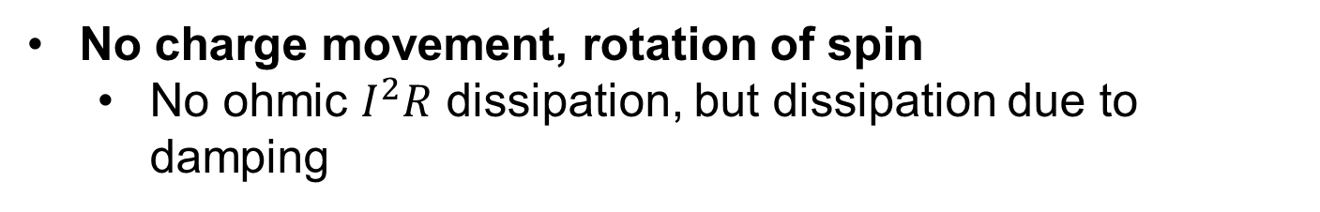
Spintronics and Nanomagnetics
Apart from having charge, an electron has spin
Spin
Up/Down 0/1 (binary information)
Charge
Electron
A rapidly developing nanotechnology
Store, non-volatile
Process
Communicate
In-built functionality
E _{barrier}
No charge movement, rotation of spin
No ohmic $I^{2}R$ dissipation, but dissipation due to damping
Khritish Kumar Behera

Slide 38
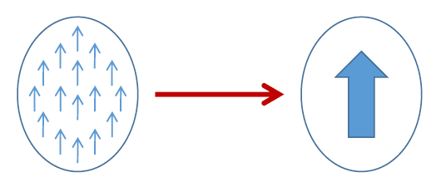
Spintronics and Nanomagnetics
Exchange interaction
Pauli’s exclusion principle
Coulomb repulsion
Each electron small magnet
Ferromagnet
Ferrimagnet
Antiferromagnet
W.F. Brown Jr.,
The fundamental theorem of the ferromagnetic particle theory
Magnetic domain formation should be limited to very small dimensions (100 nm) because of the competition between the magnetostatic energy and the quantum-mechanical exchange energy, causing nanomagnets to behave like single giant spins.
Electron beam lithography (EBL)
Khritish Kumar Behera

Slide 39



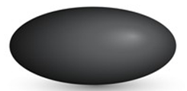
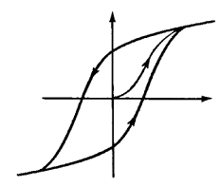

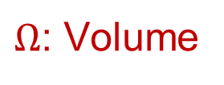




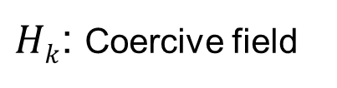

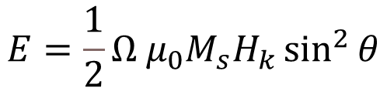


Magnetic Anisotropy
30-80 KT at 300 K
x
In-plane
Shape anisotropy
Magnetization
$$E barrier$$
$$ϕ$$
$$θ$$
z
CoFeB
y
$$φ=±90^{o}$$
$$H_{k}=\left(N_{d_ yy}−N_{d_ zz}\right)M_{s}$$
$$θ={180}^{o}$$
$$θ=0^{o}$$
Perpendicular anisotropy
Sphere
Ellipsoid
$$E=\frac{1}{2}{Ω μ}_{0}M_{s}H_{k}\sin^{2}{θ}$$
M
CoCrPt
MgO
$Hk$: Coercive field
CoFeB
$Ω$: Volume
H
t_{CoFeB}<1.3 nm
H_{k}
$$Ms in A/m$$
Bulk
Interface
Khritish Kumar Behera

Slide 40



Multiferroic and Magnetostriction
Khritish Kumar Behera

Slide 41



Multiferroic and Magnetostriction
Khritish Kumar Behera

Slide 42

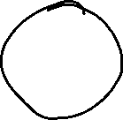






Neuron in Hardware
Khritish Kumar Behera

